Slide 1


Rishabh Software
Guide: Mr. Kshitij Tripathi
I42 Vraj Kotwala
(622079)

Slide 2

Internship Summary
Guides at Rishabh Software: Dr. Falguni Ranadive, Mr. Gagan Dubey
How Rishabh Software is different?
Rishabh Software provides software, recruitment and engineering services and solutions to mid-sized enterprises globally.
Since its inception in 1999, Rishabh Software has proudly delivered over 1000+ successful projects to its customers across 23 countries including USA, UK, Europe, Canada, Australia.
It is both product-based and service-based company.

Slide 3


Domain
Internship on Machine Learning as a domain

Slide 4

Project Definition
Sentiment Recognition with Convolutional Neural Network
Sentiment recognition is the process of identifying human emotion.
The software can detect 7 different emotions (Angry, Sad, Happy, Disgusted, Fearful, Neutral and Surprised).
It uses your system's webcam to capture your face.
The captured emotions are stored into the database with timestamp to perform further statistical analysis.

Slide 5


Tools & Technology used
Anaconda to maintain dependencies in Python 3
Spyder 3.0 IDE
Jupyter IDE
Packages used with python 3:
MySQL-Connector
NumPy
OS
OpenCV 2
Pandas
Tensorflow 2
Time

Slide 6


Introduction
Master Algorithm for Sentiment Recognition System
First, I use **Haar cascade** to detect faces in each frame of the video. I used it to collect data.
The region of image containing the face is resized to **48 x 48** and is passed as input to the 1st layer of ConvNet. This is to train the model.
Again, I use **Haar cascade** to capture faces in each frame from web cam. The network outputs a list of **Softmax Scores** for the seven classes.
The sentiment with maximum score is displayed on the screen.
The emotions will be stored into the database.

Slide 7

Ingredients of Training Algorithm
Data
Collection of Dataset.
Model
Create a model. Find some coefficients. A model, loosely speaking, is a simplification of some thing or process.
Objective Function
This function, taking data and model parameters as arguments, can be evaluated to return a number. Classification.
Optimization Algorithm
A function that minimizes an error or one that maximizes reward over punishment. By using Adam Algorithm.

Slide 8

Training an algorithm involves 4 ingredients
First we must prepare a certain amount of data to train with. Usually this is historical data which is readily available, like I have used the FER 2013 dataset which was readily available.
Second we need a model. The simplest model we can train is a linear model. That would mean to find some coefficients multiply each variable with them and sum everything to get the output.
The third ingredient is the objective function. So far we took data fed it to the model and obtained an output. We want this output to be as close to reality as possible. That's where the objective function comes in. It estimates how correct the models outputs are. On average the entire machine learning framework boils down to optimizing this function. For example, if my function is measuring the prediction error of the model I would want to minimize this error or in other words minimize the objective function.
Our final ingredient is the optimization algorithm. It consists of the mechanics through which we vary the parameters of the model to optimize the objective function.

Slide 9

Dataset Collection
Neural networks, and deep networks in particular, are known for their need for large amounts of training data.
I used the videos from YouTube to collect the data.
For gathering the dataset, I had made a python script, which used haar-cascade.xml file to identify the faces from the YouTube videos.

Slide 10
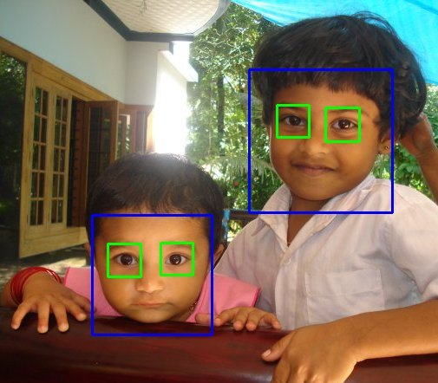
What is Haar-Cascade?
Haar-Cascade is a machine learning object detection algorithm used to identify objects in an image or video.

Slide 11
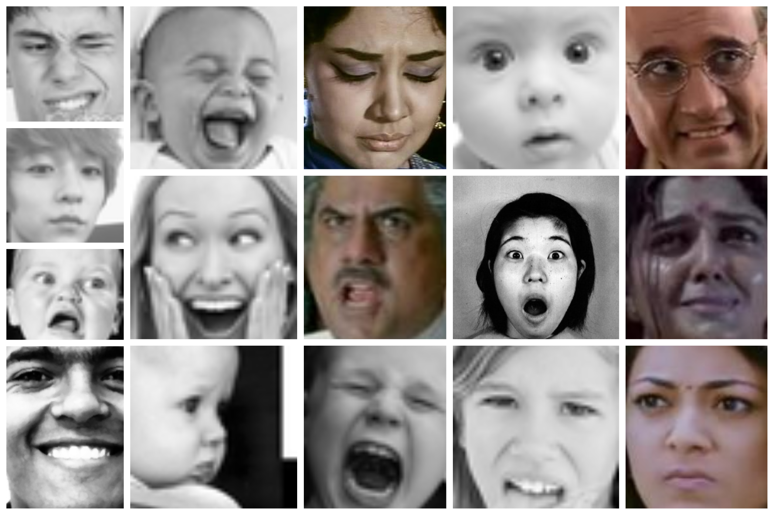
Collected Dataset merged with FER-2013 Dataset
Samples from the collected dataset combined with FER-2013

Slide 12
Ingredients of Training Algorithm
Data
Collection of Dataset.
Model
Create a model. Find some coefficients. A model, loosely speaking, is a simplification of some thing or process.
Objective Function
This function, taking data and model parameters as arguments, can be evaluated to return a number. Classification.
Optimization Algorithm
A function that minimizes an error or one that maximizes reward over punishment. By using Adam Algorithm.

Slide 13
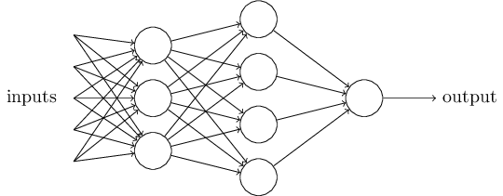

Training of model – Using Deep Convolutional Neural Network:
What is a neural network?
Creating a machine learning algorithm ultimately means building a model that outputs correct information.
Given that we've provided input data for now think of this model as a black box we feed input and it delivers an output.
We must train the model for that.
Training is a central concept in machine learning as this is the process through which the model learns how to make sense of the input data.
Once we have trained our model we can simply feed it with data and obtain an output.

Slide 14
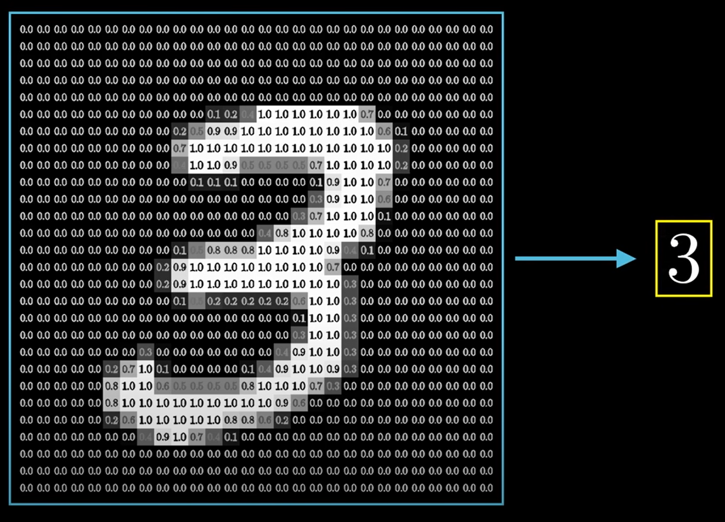

Slide 15
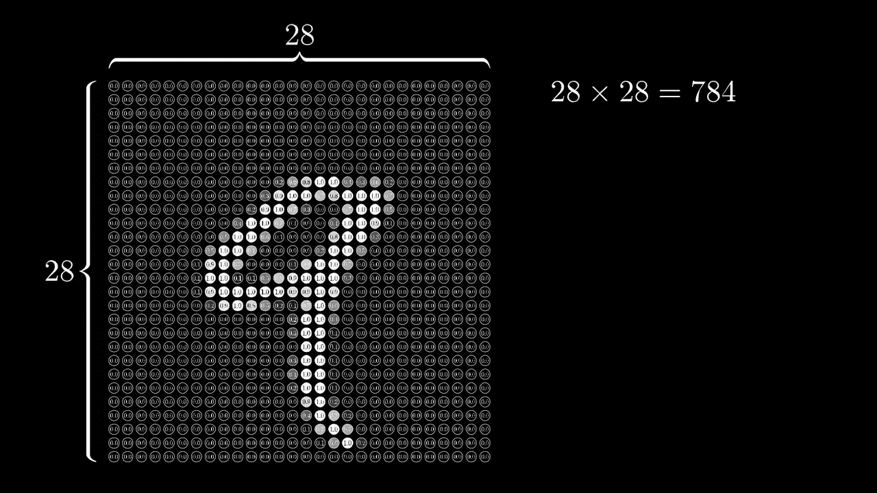

Slide 16
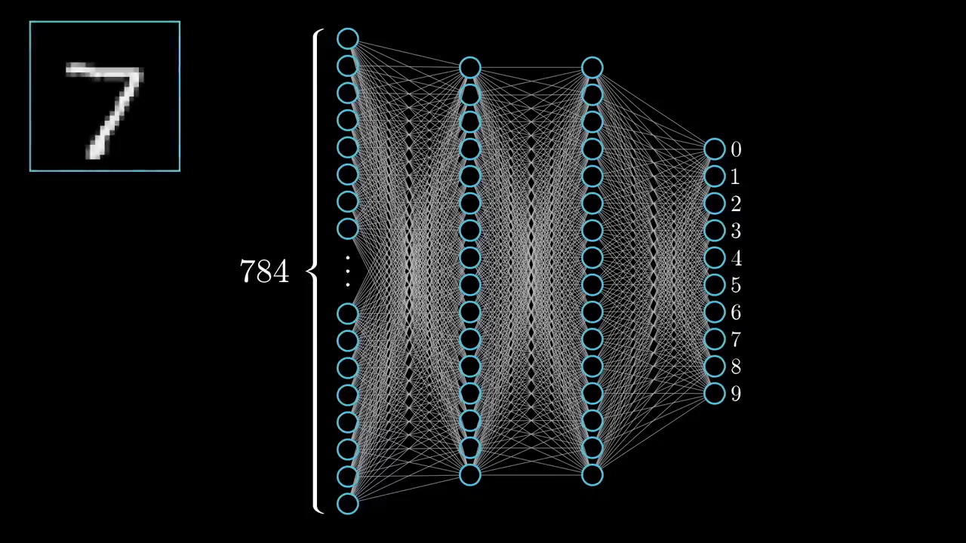
Neural Network to learn & recognize digits

Slide 17

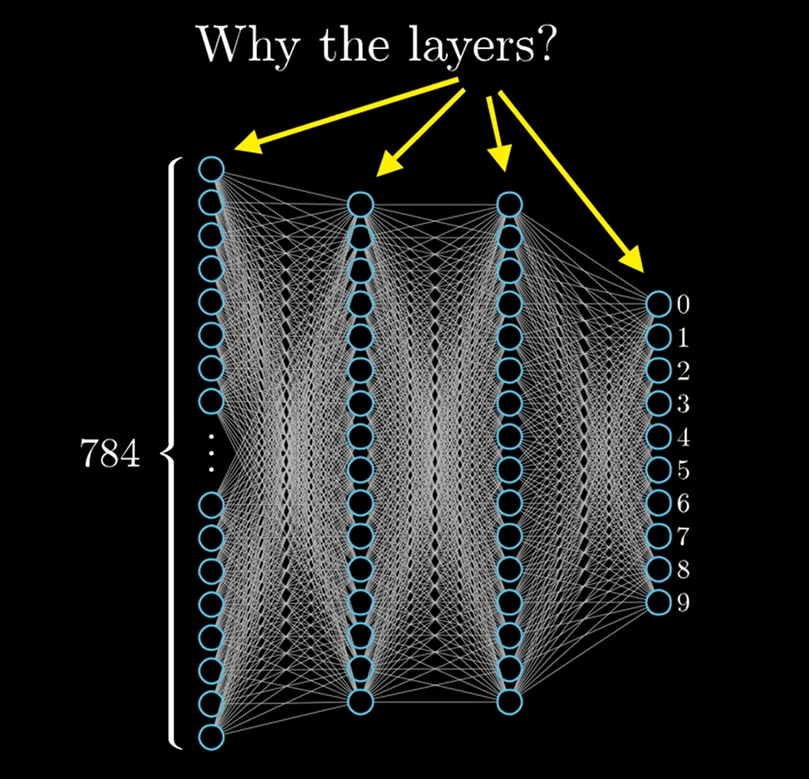
Layer
A layer is the highest-level building block in deep learning.
A layer is a container that usually receives weighted input, transforms it with a set of mostly non-linear functions and then passes these values as output to the next layer.
Single layer neural networks are very limited for simple tasks, deeper NN can perform far better than a single layer.
Hidden layers, simply put, are layers of mathematical functions each designed to produce an output specific to an intended result.

Slide 18
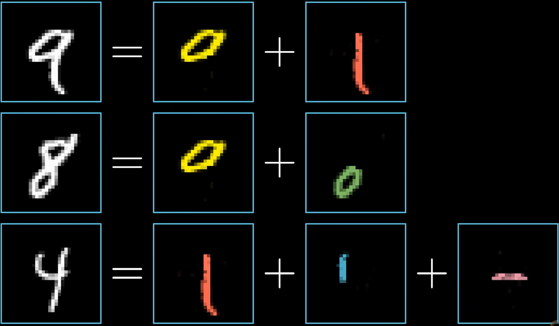

Slide 19

Pooling Layer
A pooling layer is another building block of a CNN.
Its function is to progressively reduce the spatial size of the representation to reduce the amount of parameters and computation in the network.
Pooling layer operates on each feature map independently.
The most common approach used in pooling is max pooling.

Slide 20
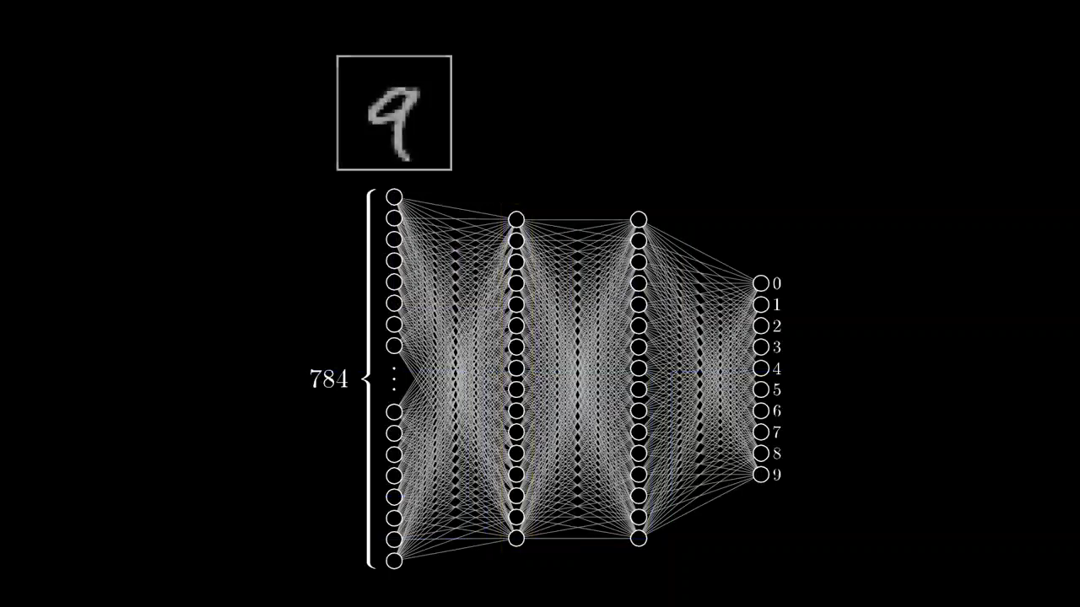
Graphical representation of hidden layers (arbitrary)

Slide 21
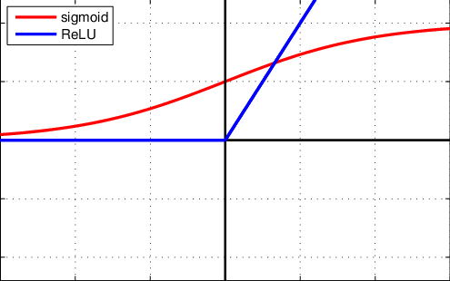
Rectifier
Mainly implemented in hidden layers of the Neural network.
We need some function that pushes the real number line in between 0 and 1. Common function that does this is called sigmoid function.
A unit employing the rectifier is also called a rectified linear unit (ReLU). Rectified linear units find applications in computer vision and speech recognition using deep neural nets.

Slide 22
Activation Function

Slide 23
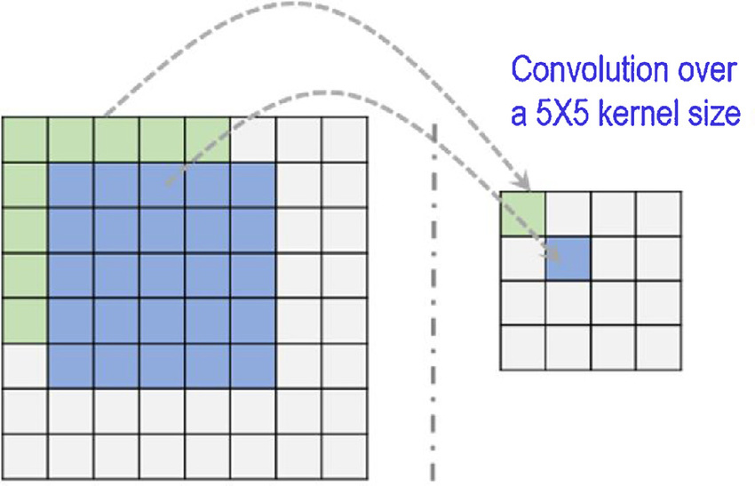
Kernel Size
Kernel Size: In image processing a Kernel is simply a 2-dimensional matrix of numbers. While this matrix can range in dimensions.

Slide 24
What are Softmax Scores?
Softmax functions are multi-class sigmoid, meaning they are used in determining probability of multiple classes at once. Since the outputs of a Softmax function can be interpreted as a probability
(i.e. they must sum to 1), a Softmax layer is typically the final layer used in neural network functions.

Slide 25


Implementation

Slide 26
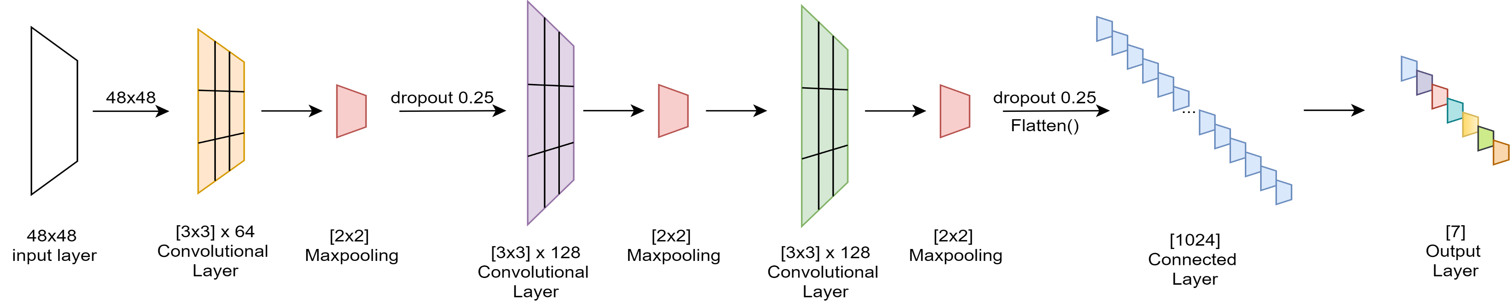
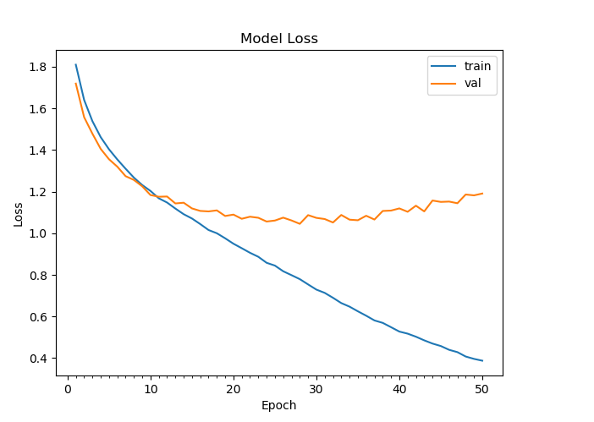
Neural Network Architecture
The software detects emotions on all faces in the webcam feed. With a simple 4-layer CNN, the test accuracy reached 73.2% in 50 epochs.

Slide 27
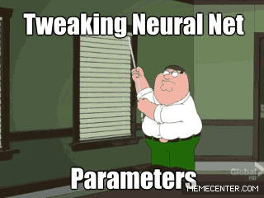

Slide 28
Ingredients of Training Algorithm
Data
Collection of Dataset.
Model
Create a model. Find some coefficients. A model, loosely speaking, is a simplification of some thing or process.
Objective Function
This function, taking data and model parameters as arguments, can be evaluated to return a number. Classification.
Optimization Algorithm
A function that minimizes an error or one that maximizes reward over punishment. By using Adam Algorithm.

Slide 29
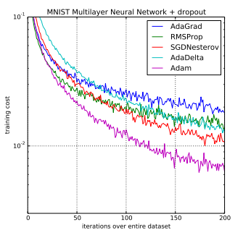
Adam – Optimizer function
Adam is an optimization algorithm that can be used instead of the classical stochastic gradient descent procedure to update network weights iterative based in training data.

Slide 30
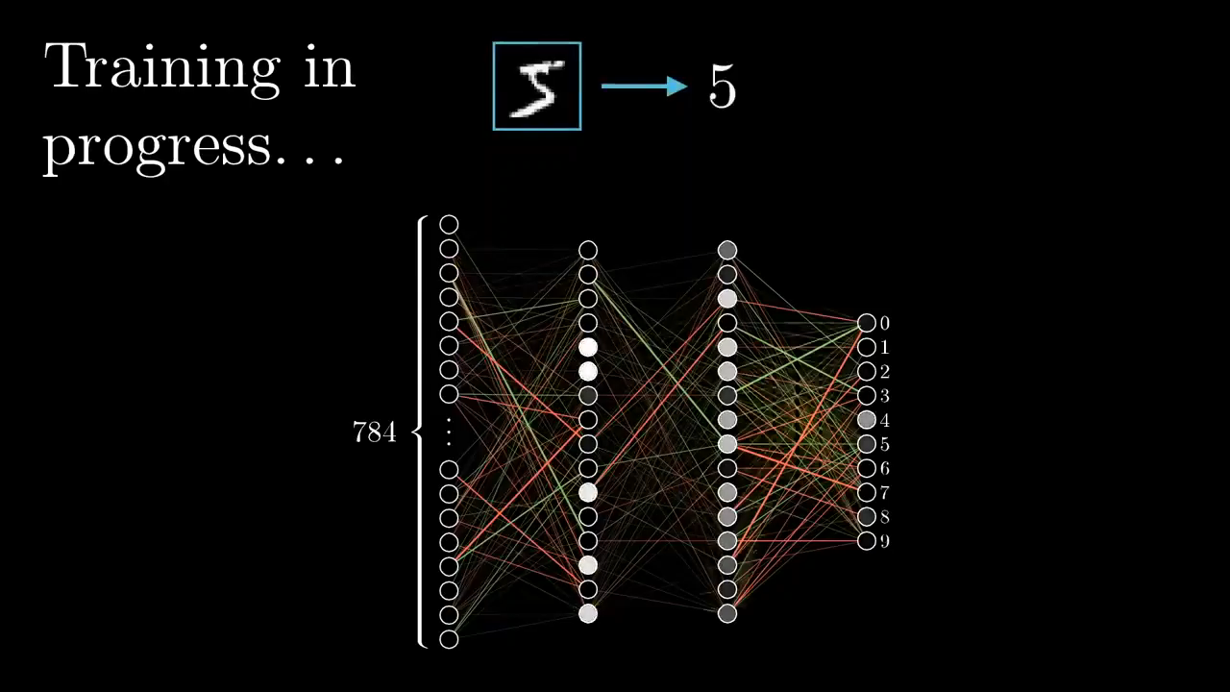
Training

Slide 31
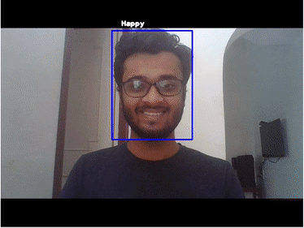
Output or Testing the model
With use of the OpenCV face recognition, the appearing face(s) from real-time video is tracked, extracted, and scaled to usable 48x48 input.
This data is then fed to the input of the neural network model, which in its turn returns the values of the output layer.
The output with the highest value is assumed to be the current sentiment of the user, and is depicted by a blue square box on the face(s).
Though, it encounters problems when shadows are present on the face of the subject. All emotions are easily recognized when acted by the user.

Slide 32
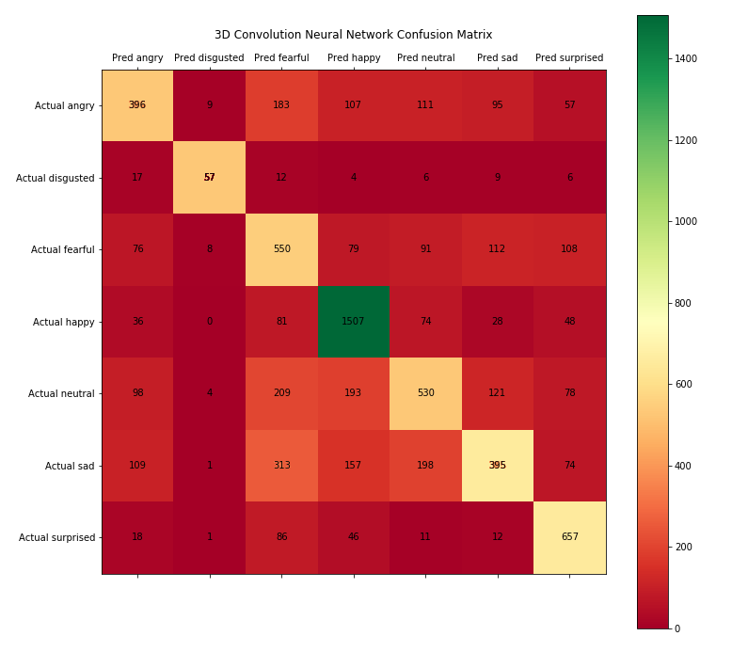
Confusion Matrix for Validation

Slide 33
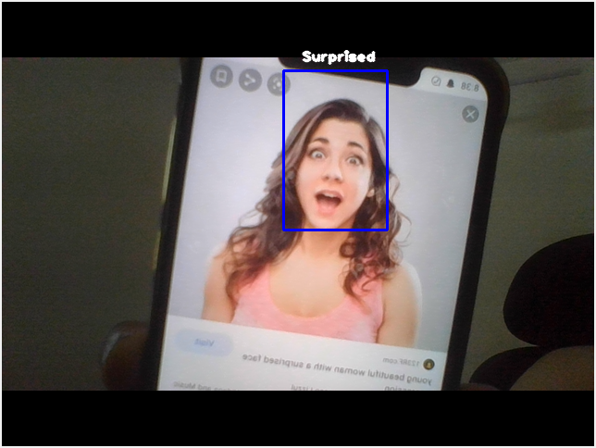
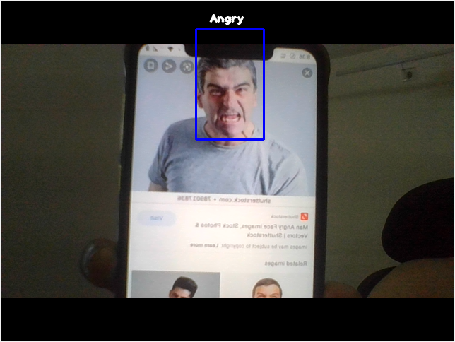
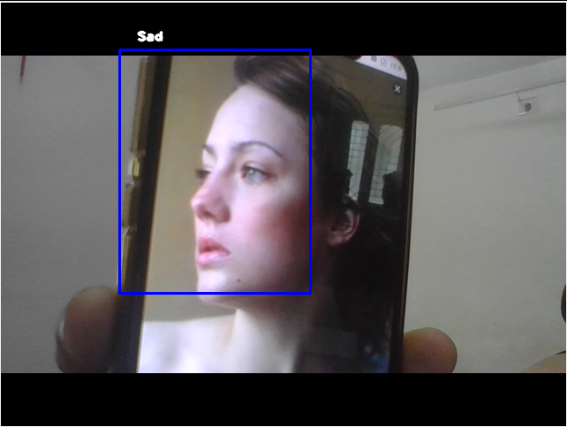
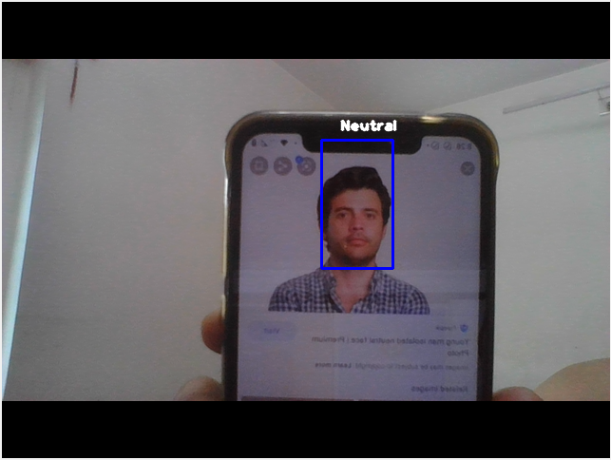
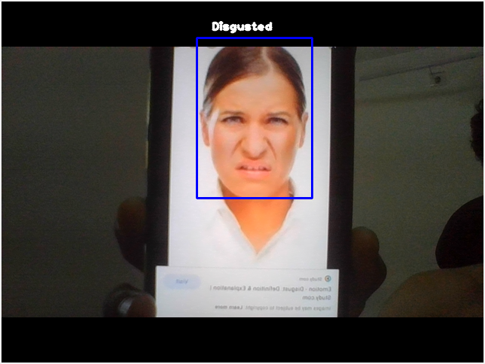
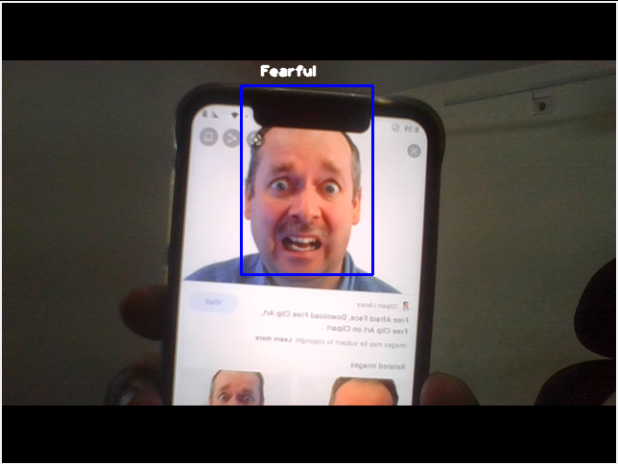
The system recognizing different emotions

Slide 34

Limitations
This does not imply it is reading your innermost feelings -- it only reads what you express outwardly.
The accuracy is very low, as there is a lot of complexity in human faces and a human face can show multiple feelings at a time.
Deploying the project is costly for Mass Surveillance

Slide 35

Data Mining
Data mining is a process of discovering patterns in large data sets involving methods at the intersection of machine learning, statistics, and database systems.
While the detected emotions were collected and stored into the database, I performed analysis on the MySQL database

Slide 36
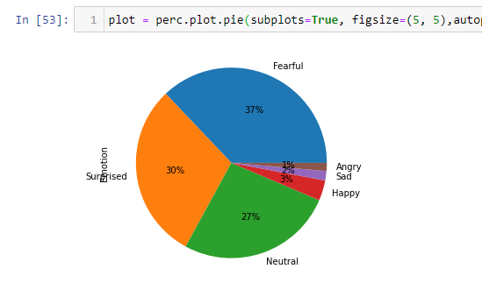
Results from Data Mining
The insights showed what I actually felt.
Due to Covid19 situation I could not perform the tests in the real world, so I performed it on myself.
Whenever I coded, my webcam recognized my emotions and stored it into the database.
Found these fascinating insights after interpreting the database: 37% of the time I'm nervous - “whether my code will work or not!” And, 30% of the time I'm surprised – “why this code worked?!”

Slide 37



January
Data Collection
February
Data Collection
Trainings on Regression, Clustering, Logistic Regression
Timeline
(Work division with respect to time)
March
Theory and study of research papers
Creating Neural Network for MNIST data.
Training of the Model
April & May
Testing Generating Report using Pandas and SQL Tweaking and Optimizing the Model
Testing

Slide 38
Thank You
I42 Vraj Kotwala
(622079)

